Slide 1
Deploying to OpenShift S2I and templates — WW Developer Advocate team

Slide 2

OpenShift Deployment – Developer view
Layer 4: Abstractions
Services, routes, PVCs, secrets etc
Layer 3: Deployments
Defines what will run in OpenShift
Layer 2: Images
Images created by build layer
Layer 1: Builds
Defines the builds required for the app
Layer 0: Base images
The base images used by the apps

Slide 3

Layer 0 – Base image examples
Base operating systems, specific runtimes, databases, application servers and more
Available as Image Streams, an enhanced set of metadata about each image
OpenShift Registry
Red Hat Container Catalog
.NET
Python
.NET core

Slide 4
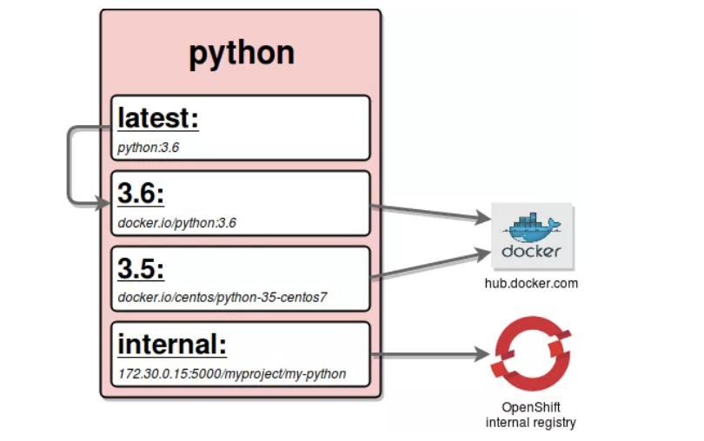
Image Streams
Image Stream example
An image stream represents one or more Docker images identified by tags.
Presents a single virtual view of related images
Can refer to images from any of the following:
Its own image repository in OpenShift’s integrated Docker Registry
Other image streams
Docker image repositories from external registries
Image Streams trigger an event when underlying image is changed (even if tag remains the same)
Graphic source: https://blog.openshift.com/image-streams-faq/
Notes:
Example Image Stream referencing a Python image
Tags 3.5 and 3.6 reference images at Docker Hub
Tag internal references an image in the internal Open Shift registry
Tag latest refers to the Image Stream tag 3.6

Slide 5
Level 1: Builds
Defined via a BuildConfig object
A blueprint for a process to transform base images + source code, app binaries, or Dockerfiles to an app image:
Key attributes:
Input (input to the build process ) - e.g. file, directory, GH repo etc
Strategy (how to build the app image)
Options:
S2I – Use a specialized builder image to generate app image (more later)
Docker - Use a Docker file to generate app image
Pipeline - A Jenkins pipeline that generates the app image from source
Custom – Encapsulate your build process via a custom builder image
Output (result of the build process) – typically an ImageStream tag

Slide 6


Level 2: Images
Defined via an ImageStream object
An abstraction for working with Docker images inside OpenShift
Key attributes:
ImageStreamImage (reference to actual image) - typically not used directly
ImageStreamTag (reference to a given ImageStream and tag)
Key: ImageStreamImage
ImageStreamTag
IBM Developer

Slide 7
Level 3: Deployments
Defined via a DeploymentConfig object
Encapsulates the K8s Deployment and adds deployment strategies and triggers
Key attributes:
Strategy (how to deploy if the underlying Deployment is already deployed)
Options:
Recreate– Blow away old deployment first and then deploy new one
Rolling (default) – Zero downtime rollout via K8s RollingUpdate
Advanced - (Note: require routes)
Blue-Green - running 2 versions of the deployment at the same time and moving traffic from the in-production version (the green version) to the newer version (the blue version).
A/B – partitioning requests between 2 versions of the deployment at the same time and observing the behavior
Triggers (define conditions under which the deployment is automatically triggered)
e.g Input image updated, config changes

Slide 8
Level 4: Abstractions
Defines all of the additional resources needed for an app like networking, storage, security etc
Frequently used resources: (there are several others)
Service – Internal load balancer and router. Directs network traffic to replicated Pods
Route – Exposes a Service at a defined host name to allow access from external traffic
Persistent Volume Claim – Permanent storage used by apps to persist data after the app has stopped running
Secret – Mechanism for holding sensitive data. Decouples sensitive data from the the Pods that use them.

Slide 9
S2I provides a repeatable method to generate application images from source/binary code

Slide 10

S2I Overview
S2I is a tool that merges source code or binary into an application specific image
Uses a builder image
OpenShift provides multiple builder images
e.g. Node.js, Java
Can create and add your own
Layer 4: Abstractions
Layer 3: Deployments
Layer 2: Images
App Image
Layer 1: Builds
S2I
Layer 0: Base images
Builder Image

Slide 11
Anatomy of an S2I Builder Image
Docker file contains S2I specific labels and env vars | LABEL io.openshift.s2i.scripts-url=image:///usr/local/s2i \ io.s2i.scripts-url=image:///usr/local/s2i \ io.k8s.description=” S2I for Open Liberty Profile" \ io.k8s.display-name="Liberty 19.0.0.4 javaProfile7" \ io.openshift.expose-services="9080/tcp:http" \ io.openshift.tags="runner, builder,liberty" \ io.openshift.s2i.destination="/tmp" ENV STI_SCRIPTS_PATH="/usr/local/s2i" \ S2I_DESTINATION="/tmp"
Provides base image for applications generated from the S2I image | # This S2I image provides a base for building and # running WebSphere Liberty applications. FROM websphere-liberty:javaee7
A series of scripts | assemble – Compiles and/or assembles app components from input (required) run – Command to run generated app image (required) usage – Outputs usage info about the generated image (optional) save-artifacts – Saves artifacts to support incremental builds (optional)

Slide 12
Templates provide a parameterized set of objects that can be processed by OpenShift

Slide 13
Templates Overview
Templates typically contain parameterized objects for the various layers of the deployment process for an app or service
Once created they are tightly integrated with the Web console and CLI
Simplifies the deployment of apps or services that require several objects to be created
OpenShift includes several templates that can be used OOTB
e.g. Jenkins, MariaDB etc
Templated objects
Layer 4: Abstractions
Routes, Services etc
Layer 3: Deployments
DeploymentConfig
Layer 2: Images
ImageStream
Layer 1: Builds
BuildConfig
Layer 0: Base images

Slide 14
Anatomy of a Template
Metadata with name, description | apiVersion: v1 kind: Template metadata: name: pbw-liberty annotations: openshift.io/display-name: Plants by WebSphere on Liberty w/MariaDB description: Plants by WebSphere on Liberty App using MariaDB as the database tags: liberty,websphere iconClass: icon-liberty openshift.io/provider-display-name: IBM Client Dev Advocacy. openshift.io/documentation-url: https://github.com/djccarew/app-modernization-plants-by-websphere-jee6.git openshift.io/support-url: https://developer.ibm.com
Parameters | parameters: - name: APPLICATION_NAME displayName: Application name description: The name for the application. value: pbw-liberty-mariadb required: true …
Parameterized objects | - apiVersion: image.openshift.io/v1 kind: ImageStream metadata: name: "${APPLICATION_NAME}" …

Slide 15
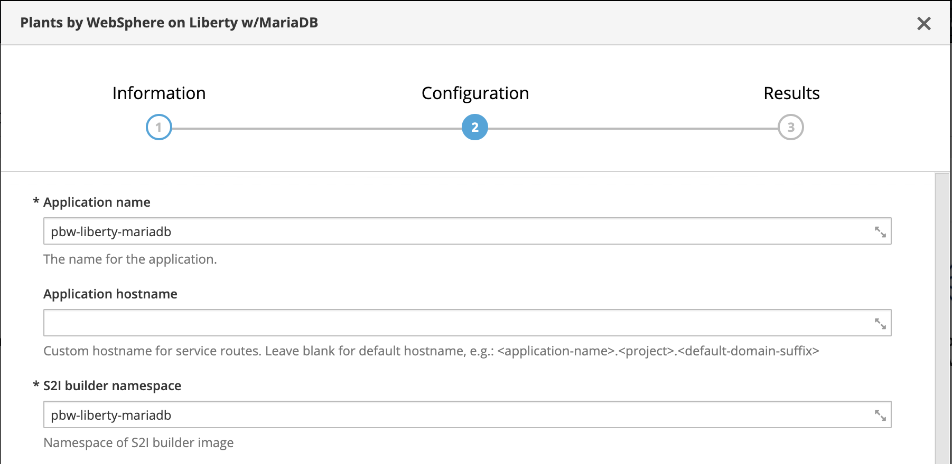
Using a template
From Web console
1 .Select template
From CLI
Apply template and specify parameters by running oc process and then piping the result to oc create
$ oc process –f pbw-liberty \
-p APPLICATION_HOSTNAME=foobar.com \
| oc create -f -
2. Apply parameters

Slide 16
Example – Deploy Plants by WebSphere app w/MariaDB
Route: pbw-liberty-http
Service: mariadb
Layer 4: Abstractions
Service: pbw-liberty-http
Secret: mariadb
DeploymentConfig: pbw-liberty
pbw-liberty-mariadb: mariadb
Layer 3: Deployments
Layer 2: Images
ImageStream: pbw-liberty
Layer 1: Builds
BuildConfig: pbw-liberty
Layer 0: Base images
ImageStream: Liberty S2I
Image Stream: mariadb
pbw-liberty template
mariadb template

Slide 17
Resources
S2I
https://docs.openshift.com/container-platform/3.11/creating_images/s2i.html
OpenShift Templates
https://docs.openshift.com/container-platform/3.11/dev_guide/templates.html
Example Repo https://github.com/IBMAppModernization/app-modernization-plants-by-websphere-jee6

